Slide 1



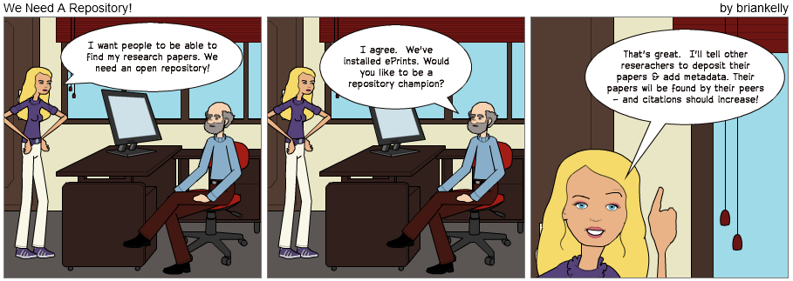
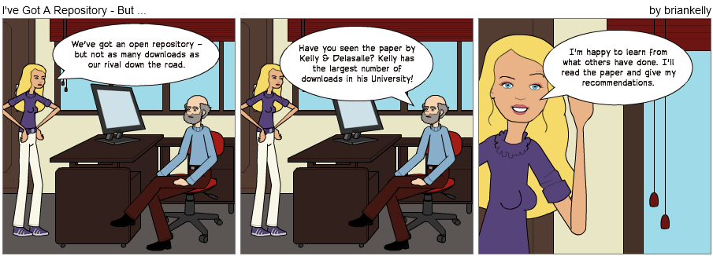
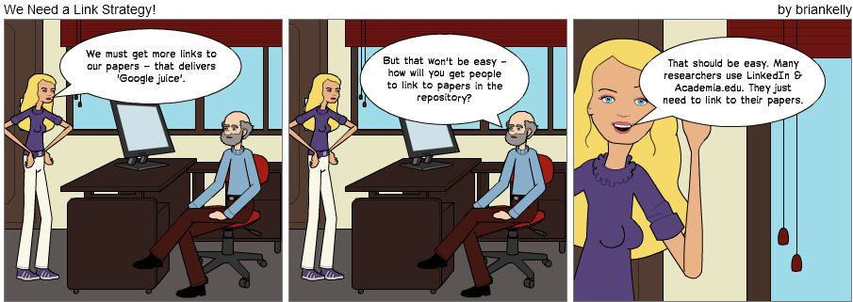
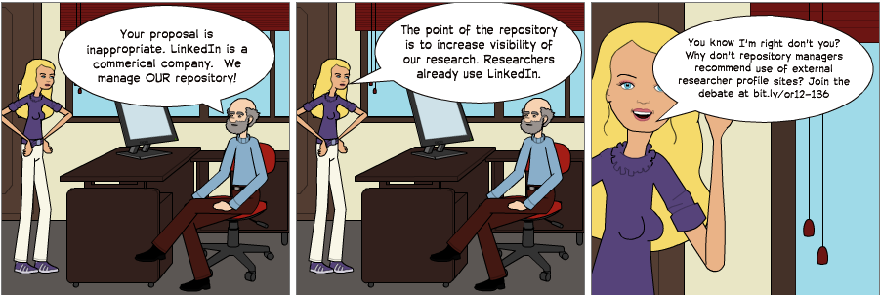
Can LinkedIn and Academia.edu Enhance Access to Open Repositories?
Install and promote a repository in order to enhance access to research papers?
We know that makes sense and we’ve been doing this.
Brian Kelly (UKOLN) has had the largest number of downloads on Opus, the University of Bath repository. He has a h-index of 11 with his accessibility papers being well-cited.
Research by Kelly & Delasalle suggests that the large number of downloads (& citations) may be due to inbound links from popular services.
Further research is needed. But in the meantime why wouldn’t you encourage researchers to link to their papers from popular profile services used by their fellow researchers?
Acknowledgements are given to JISC for their funding of the Innovation Support Centre at UKOLN.
Can LinkedIn and Academia.edu Enhance Access to Open Repositories?
Brian Kelly and Jenny Delasalle, OR12, Edinburgh, 9-13 July 2012.
http://opus.bath.ac.uk/30227/
Please contact Brian Kelly for further information about this work: <b.kelly@ukoln.ac.uk>

